Slide 1


Scale-free Network: an overview
Index:
Degree Distribution
Power Laws
Hubs
The Meaning of Scale-Free
Working with Network
Case Study: The stock market
Raffaele Cavaliere M62/2656
Alessandro Cicalese M62/2847

Slide 2
Index:
What is a Network?
Degree Distribution
Hubs
The Meaning of Scale-Free
Working with Network
Case Study: The stock market

Slide 3
Scale-free Network: an overview
Degree Distribution
Index:
What is a Network?
Degree Distribution
Hubs
The Meaning of Scale-Free
Working with Network
Case Study: The stock market
Raffaele Cavaliere
Alessandro Cicalese

Slide 4
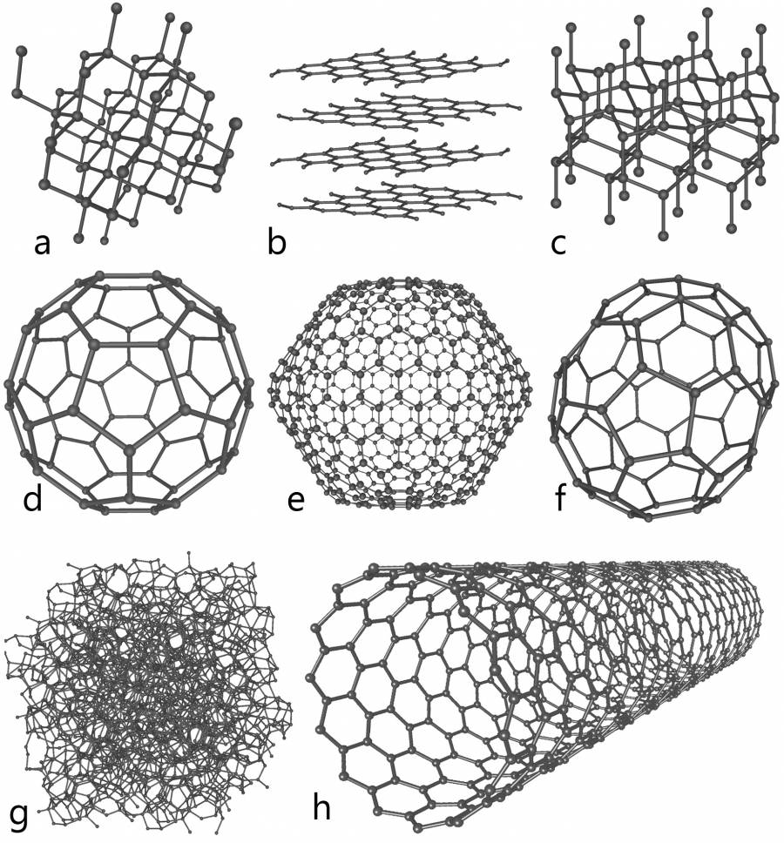
What is a Network?
Carbon atom structures
A network is a representation of:
System's components (NODES)
Component interactions (LINKS)
The number of nodes defines the size of the system!
!

Slide 5
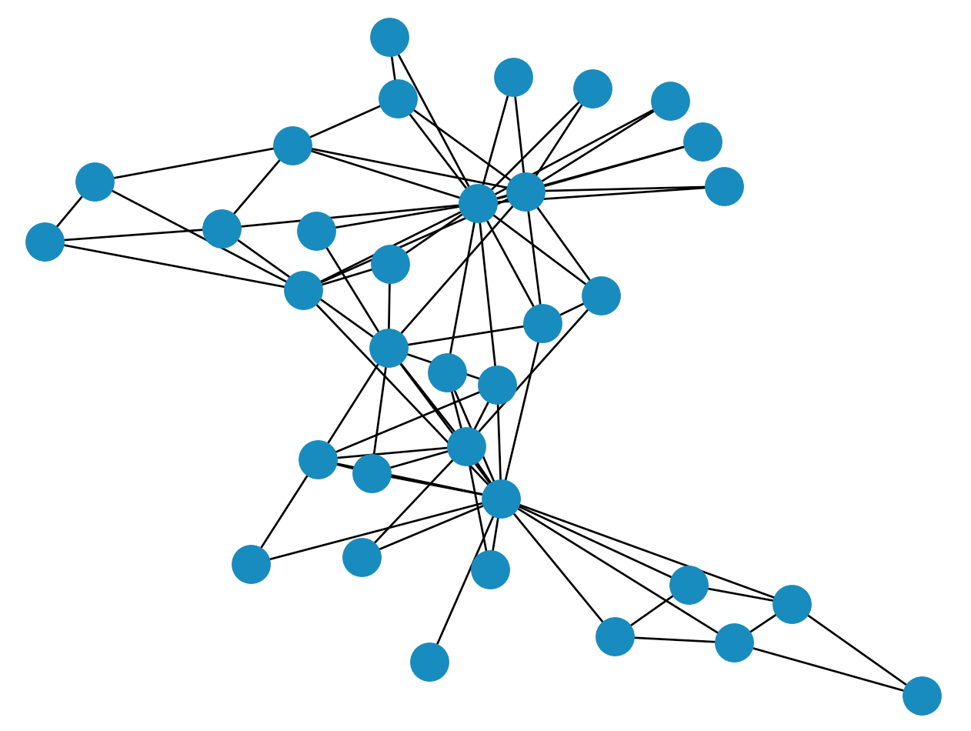
Graph vs Network
What is a Network?
The term "graph" is often used
interchangeably, but it typically refers
to the mathematical representation of networks.
A network is a representation of:
System's components (NODES)
Component interactions (LINKS)
While networks describe real systems, graphs pertain to the abstract mathematical structure.

Slide 6
What is a Network?
Carbon atom structures
A network is a representation of:
System's components (NODES)
Component interactions (LINKS)
The number of nodes define the size of our system!
!

Slide 7
Scale-free Network: an overview
Degree Distribution
Index:
What is a Network?
Degree Distribution
Hubs
The Meaning of Scale-Free
Working with Network
Case Study: The stock market
Raffaele Cavaliere
Alessandro Cicalese

Slide 8
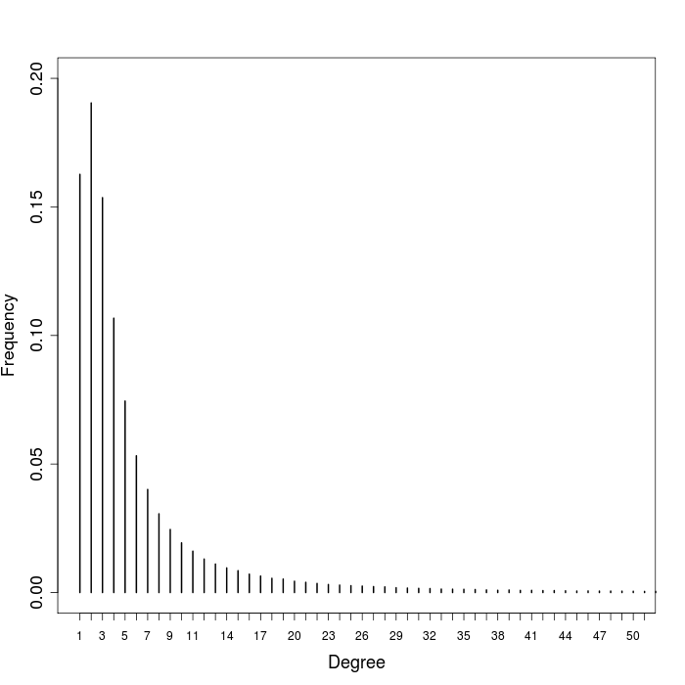
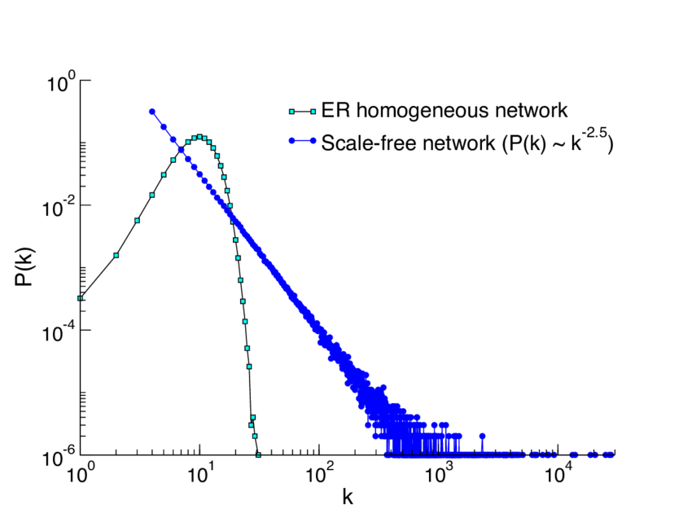

Degree Distribution
$$p\left(k\right)$$
is the probability that a randomly chosen
node in the network has a specific degree
$$k$$
Degree Distribution

Slide 9
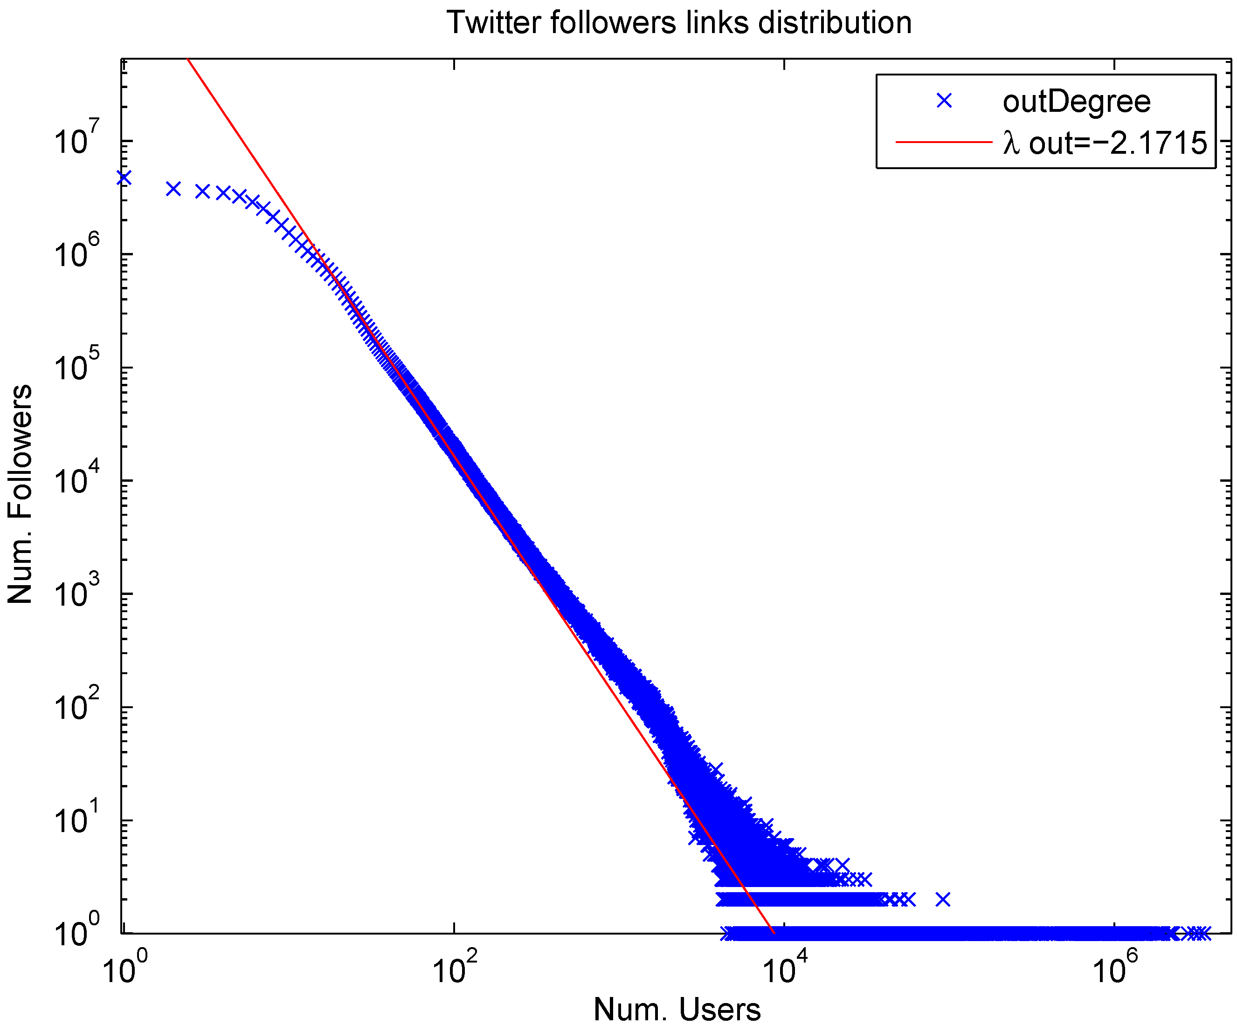

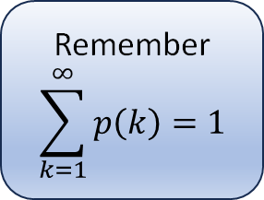


Power-Law Distribution
Scale–Free networks follow a power-law distribution
Remember
$$\sum_{k=1}^{∞}{p\left(k\right)=1}$$
$$p\left(k\right) \sim αk^{−γ}$$
$$with γ>0$$
If we take the logarithm we get:
$$\log\left(p\left(k\right)\right)\sim −γ∗\log\left(k\right)+C$$
this means that on a double logarithmic
scale we can see a straight line

Slide 10
Index:
What is a Network?
Degree Distribution
Hubs
The Meaning of Scale-Free
Working with Network
Case Study: The stock market

Slide 11

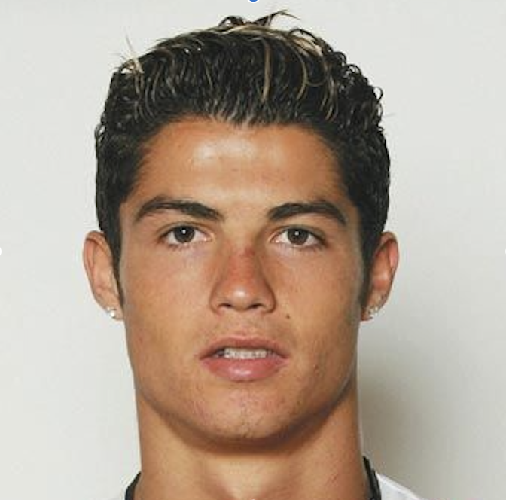
Hubs in Networks
Hub: A highly connected node in a network
In a scale-free networks hubs:
are disproportionately big compared to higher nodes
have a high probability of being observed

Slide 12
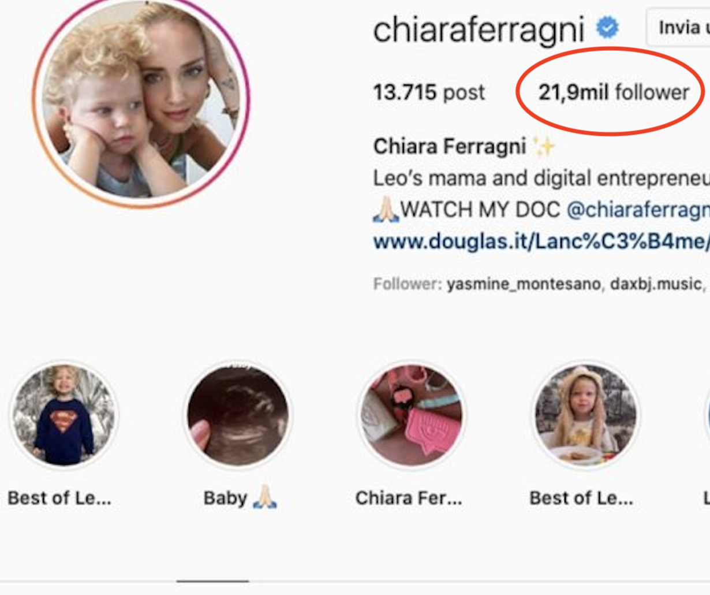
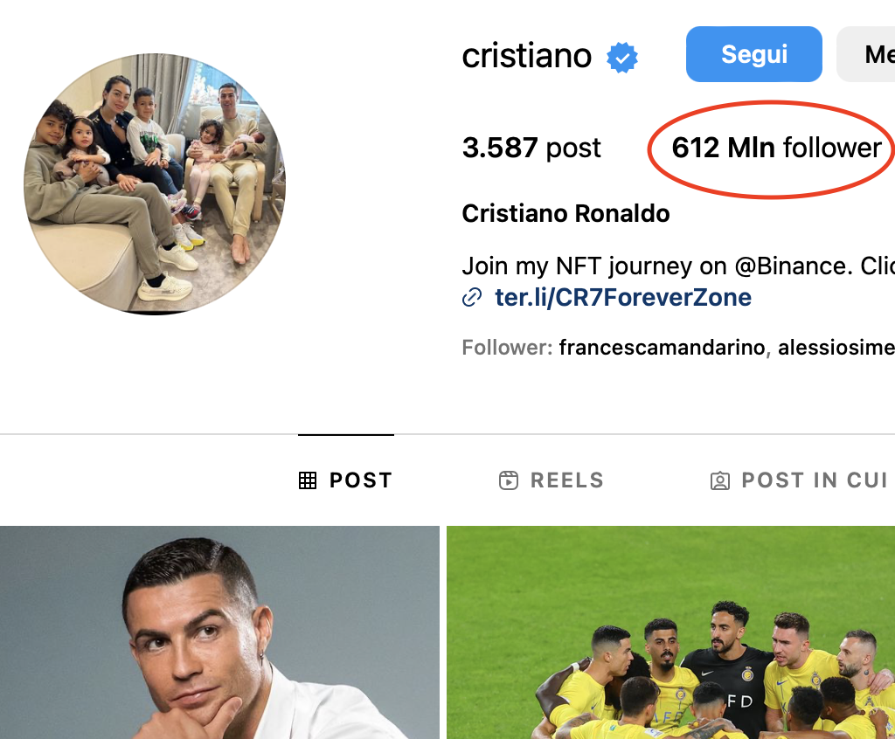
Hubs in Networks
Hub: A highly connected node in a network
In a scale-free networks hubs:
are disproportionately big compared to higher nodes
have a high probability of being observed

Slide 13
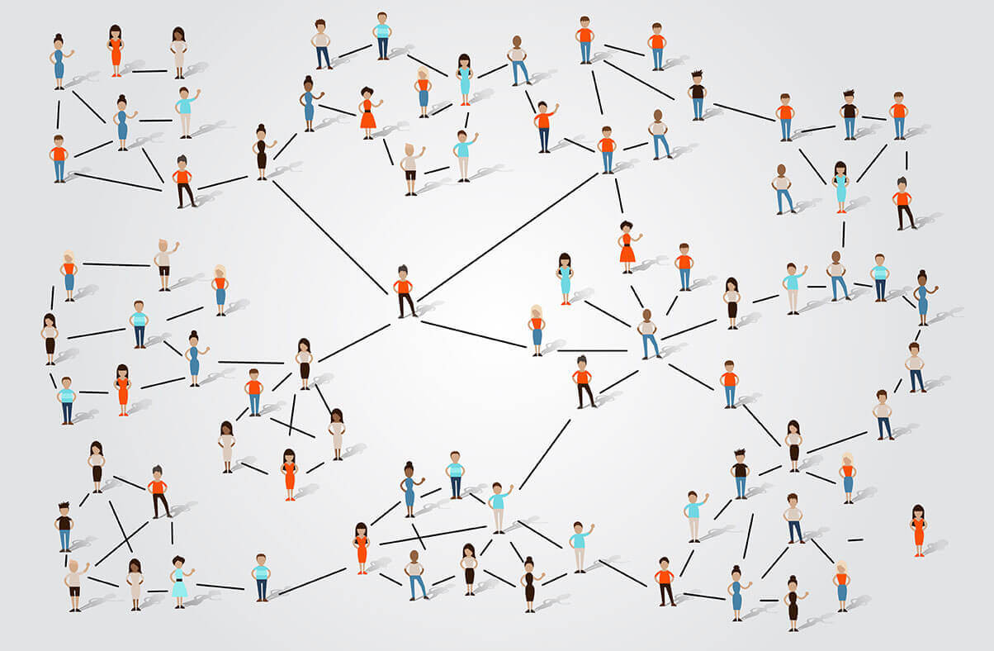
Small World Phenomenon
“Any two individuals, regardless
of their location on Earth, can be connected through a chain of
at most six acquaintances”
Hubs connect various parts of the network, reducing average path lengths
Scale-free networks maintain a high clustering coefficient, indicating strong local connections
LOCAL COHESION – GLOBAL REACH

Slide 14
Index:
What is a Network?
Degree Distribution
Hubs
The Meaning of Scale-Free
Working with Network
Case Study: The stock market

Slide 15



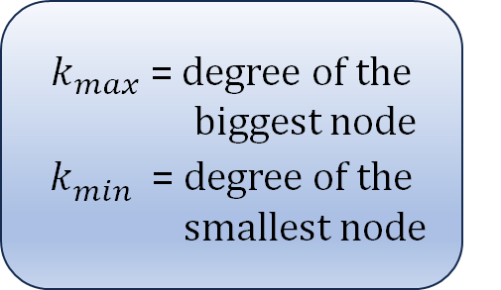



Moments of a Distribution
$E\left[k^{n}\right]= \sum_{k_{min}}^{k_{max}}{k^{n}p(k)}$ $∝ \frac{k_{max}^{n−γ+1} −k_{min}^{n−γ+1}}{n−γ+1}$
$k_{max}^{}$ = degree of the biggest node
$k_{min}^{}$ = degree of the smallest node
$$n=1: average degree \\ n=2: help us calculate the variance \left(E\left[k^{2}\right] −{E\left[k\right]}^{2}\right) \\ n=3: tells us how symmetric the distribution is$$
$$\{$$
$$for n≤γ−1$$
$$E\left[k^{n}\right] is finite$$
$$k_{max}→ ∞$$
$$for n>γ−1$$
$$E\left[k^{n}\right] diverges$$

Slide 16
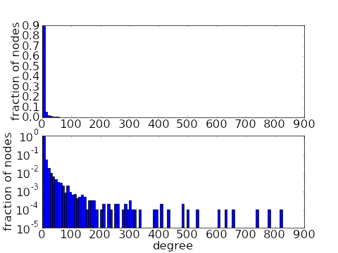

Scale-free Networks Lack a Scale
For a scale-free network 𝛾 < 3. Thus, $E\left[k^{2}\right] and E\left[k^{3 }\right] go to infinity$
Networks with γ ‹ 3 do not have a meaningful internal scale, but are SCALE-FREE!
The variance diverge for large N meaning that the fluctuations around the average can be arbitrary large

Slide 17
Index:
What is a Network?
Degree Distribution
Hubs
The Meaning of Scale-Free
Working with Network
Case Study: The stock market

Slide 18
Working with Network
Plotting the Degree Distribution
Measuring the Degree Exponent
Shape of Real Network

Slide 19
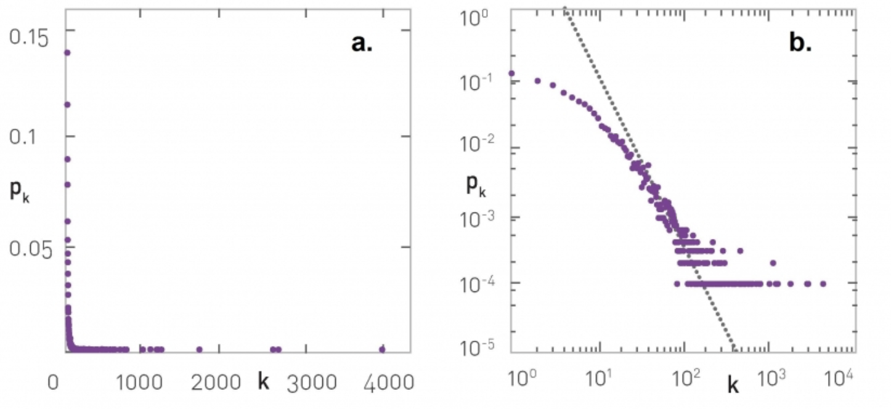
Working with Network
We have nodes with widely different degrees,
a linear plot is unable to display them all.
Plotting the Degree Distribution
Use a log-log plot!
Measuring the Degree Exponent
Shape of Real Network

Slide 20
Working with Network
Plotting the Degree Distribution
Measuring the Degree Exponent
Shape of Real Network

Slide 21

Working with Network
$$p\left(k\right)\sim {αk}^{−γ} → power−law$$
log (p(k)) ~ $−γ\log\left(αk\right)$
$$\text{log} \text{(}\text{p}\text{(}\text{k}\text{))} \sim −γ log\left(k\right)− γ log\left(α\right)$$
$y \sim a_{0}x+a_{1}→ LINEAR REGRESSION!$
Plotting the Degree Distribution
Measuring the Degree Exponent
Shape of Real Network

Slide 22
Working with Network
Plotting the Degree Distribution
Measuring the Degree Exponent
Shape of Real Network

Slide 23
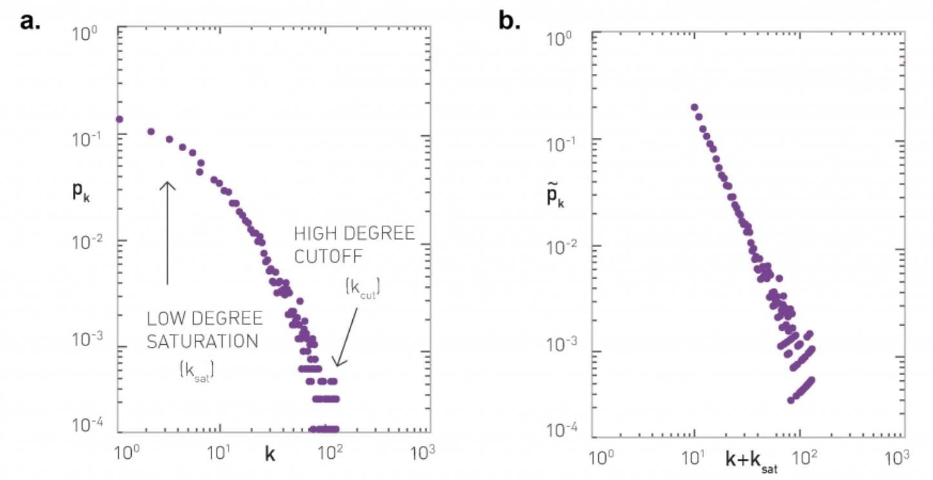
Working with Network
1. Low-degree saturation, we have fewer small degree nodes than expected
Plotting the Degree Distribution
2. High-degree cutoff, fewer high-degree nodes than expected
Measuring the Degree Exponent
Shape of Real Network

Slide 24
Working with Network
Plotting the Degree Distribution
Measuring the Degree Exponent
Shape of Real Network

Slide 25
Index:
What is a Network?
Degree Distribution
Hubs
The Meaning of Scale-Free
Working with Network
Case Study: The Stock Market

Slide 26
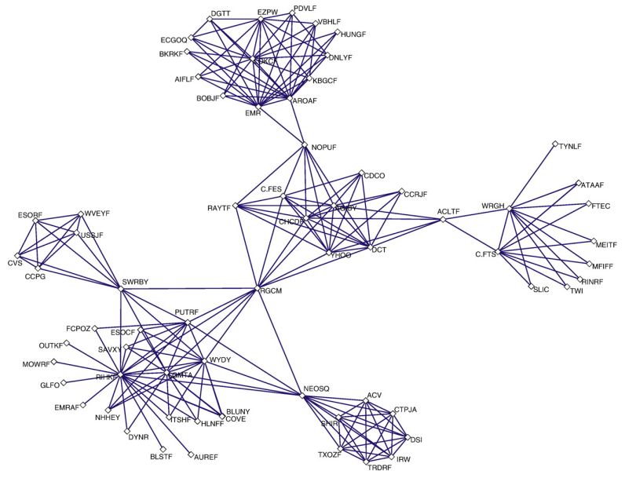

A Network Perspective of the Stock Market

Slide 27
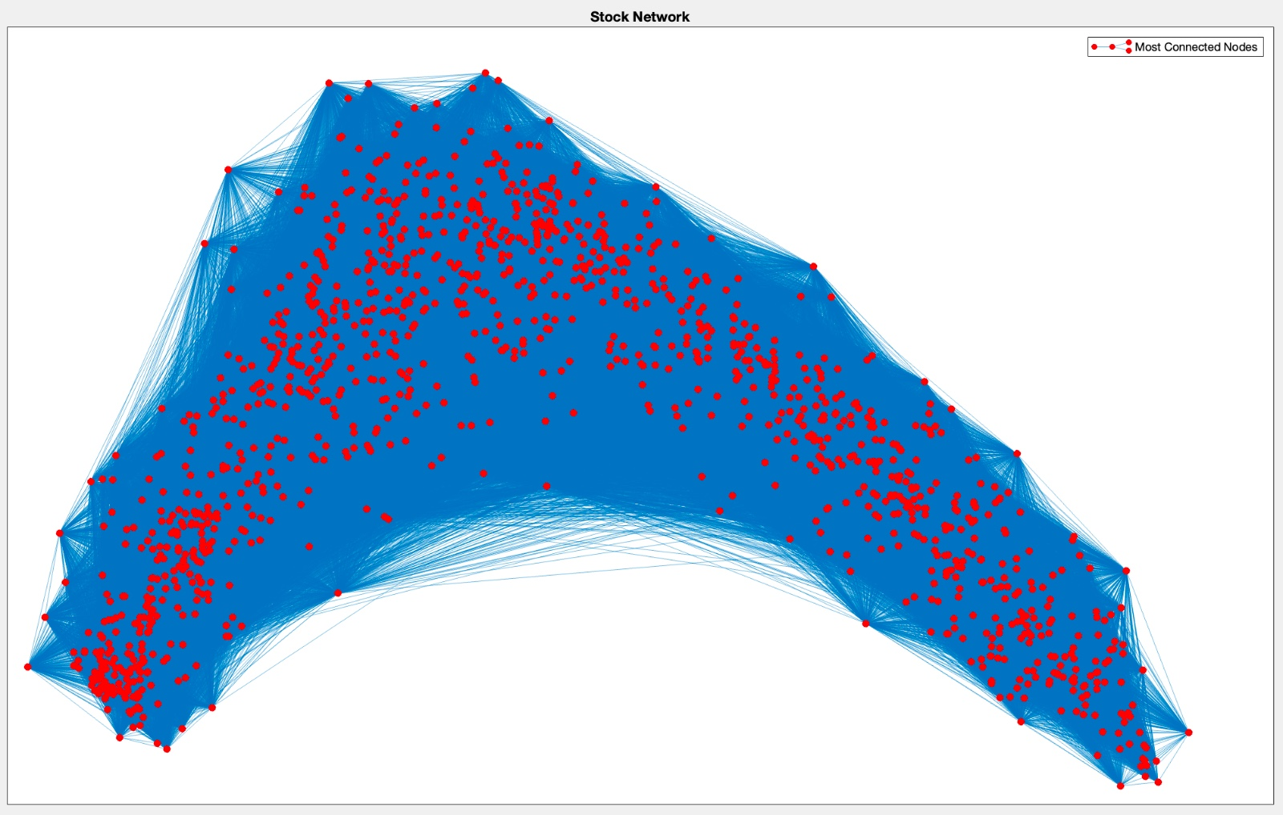
Network construction
Node
Single stock in the market
Edge
Connection by correlation
What is a stock?
Share of ownership in a company traded on the stock market

Slide 28
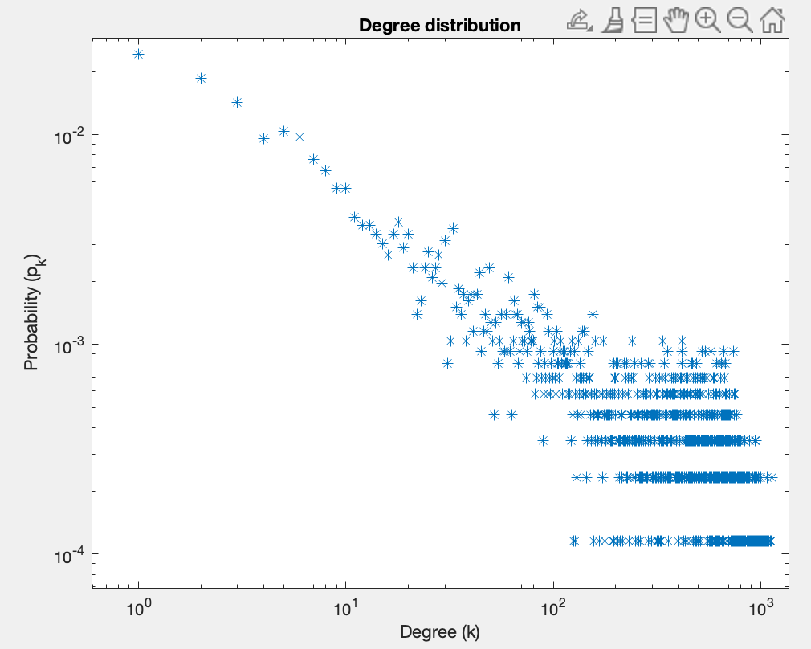
Degree Distribution

Slide 29
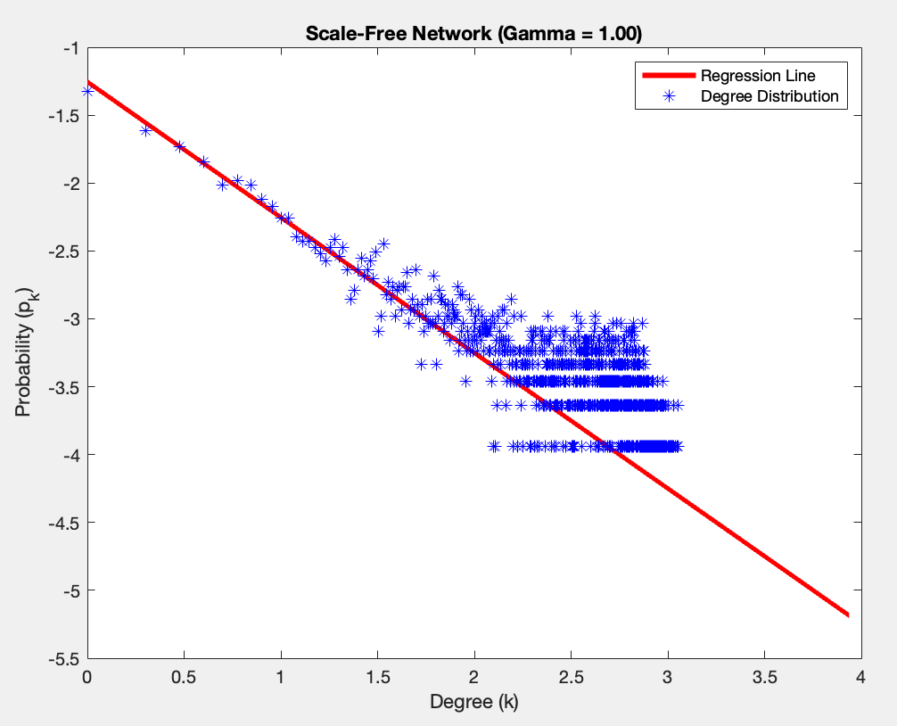
Exponent Estimation

Slide 30
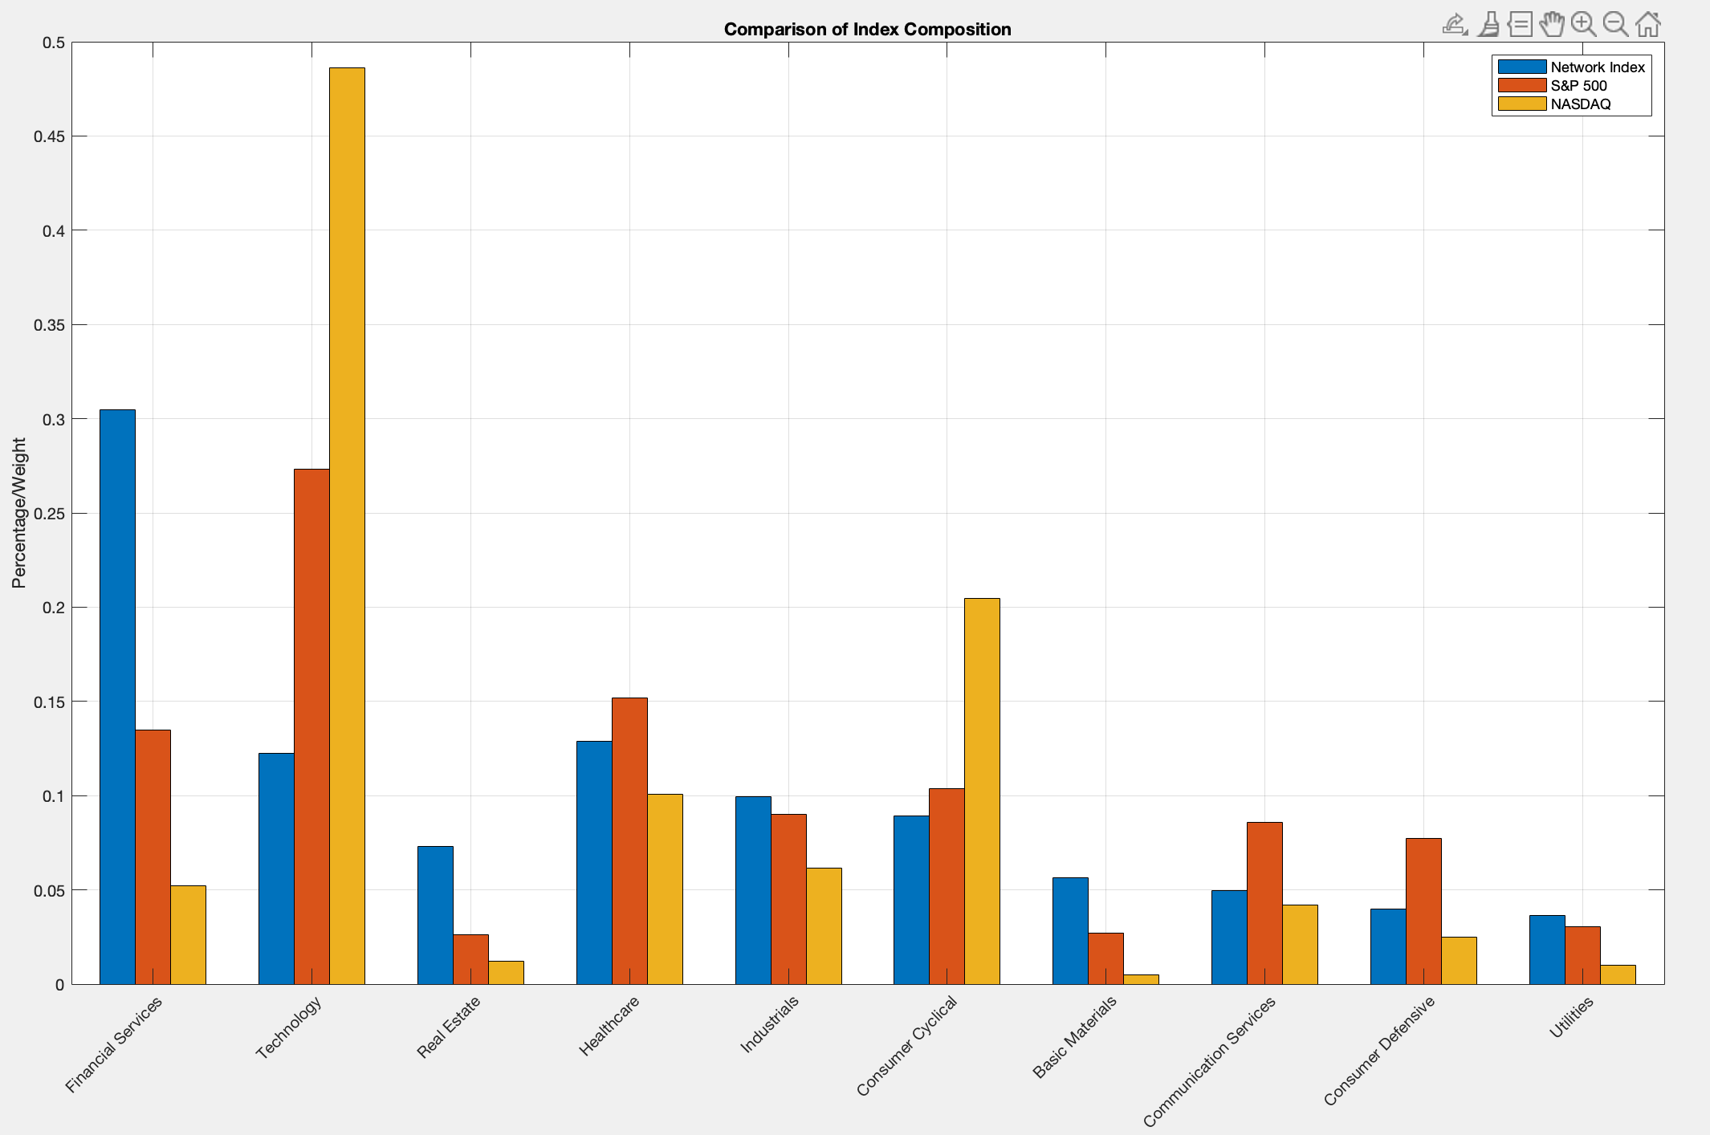
CONCLUSIONS
The market is heavily influenced by stocks in the financial sector!

Slide 31
Thank you for the attention!

